Slide 1
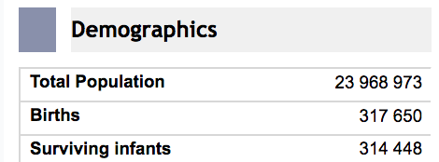
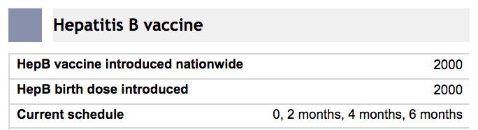
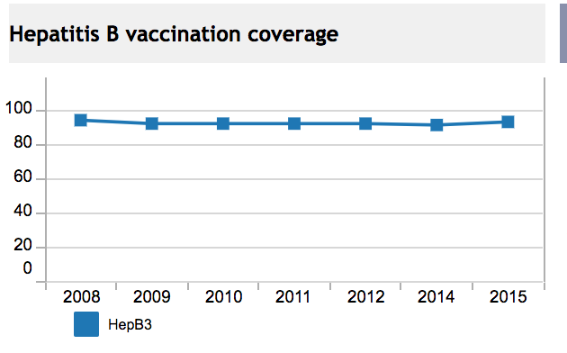



USER INPUT CONTROL
VISUALIZATIONS
VIZ-A
VIZ-B
(possible graph)
VIZ-C

Slide 2
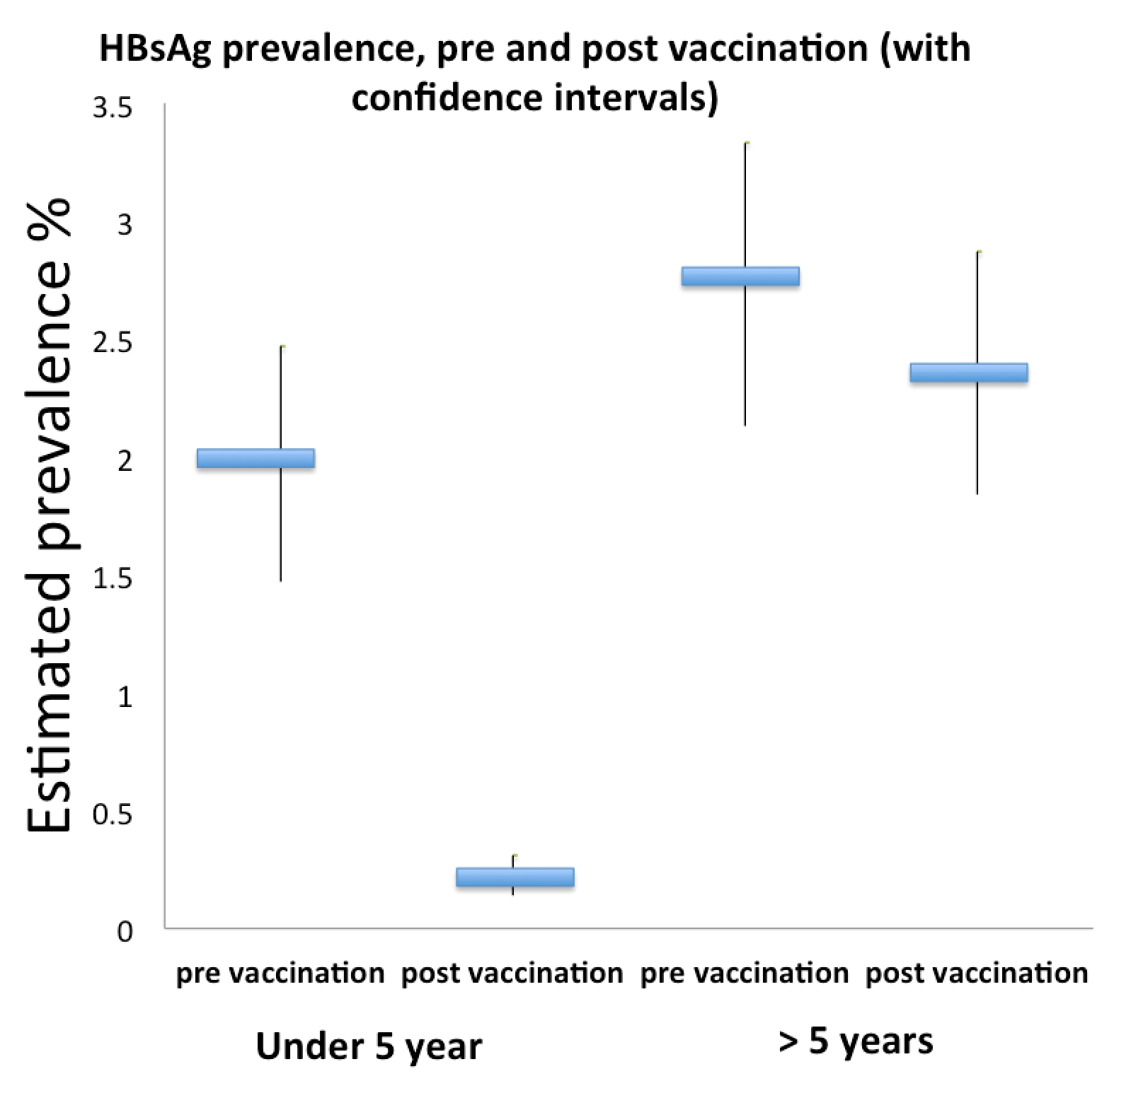
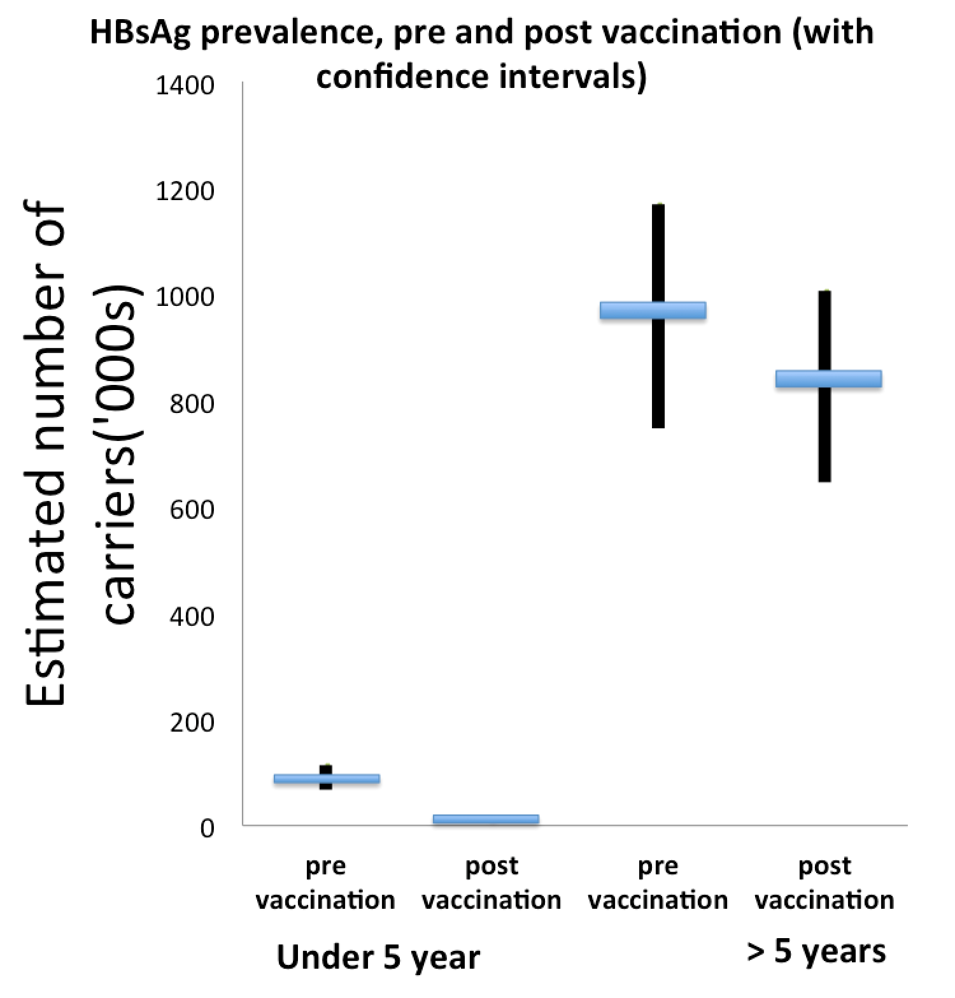
VIZ-D
Graph1
Graph2
Hover Function
Estimate = 900,000
Lower CI = 700,000
Upper CI = 1.1 Million
General Population
General Population
Graph 3 (Number of carriers prevented ('000s) not pictured.
We will also add to this graph data for the relevant region and income class.

Slide 3
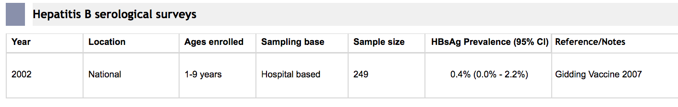
VIZ-E

